Slide 1
Control Presentation
Rami Wail - Ahmed Alaa - Mohamed el shafey

Slide 2
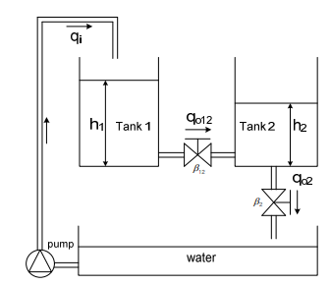

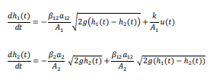
The system

Slide 3
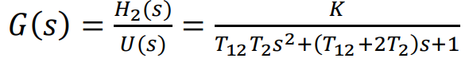
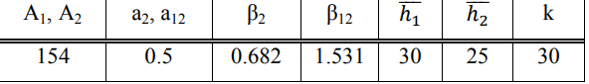


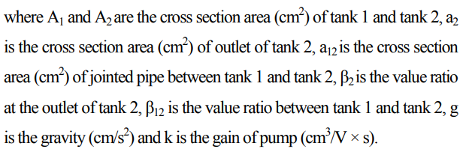

Slide 4
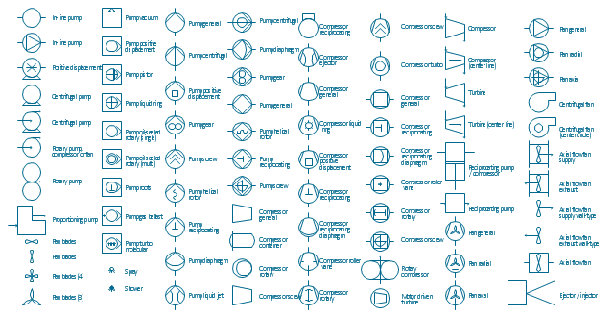
Hardware
Pump “Motor”
Tanks “containers”
Sensor “ultrasonic most probably”
Water tap
Tubes
Hose
Water valve
PID-Controller
Bread board ,wires

Slide 5
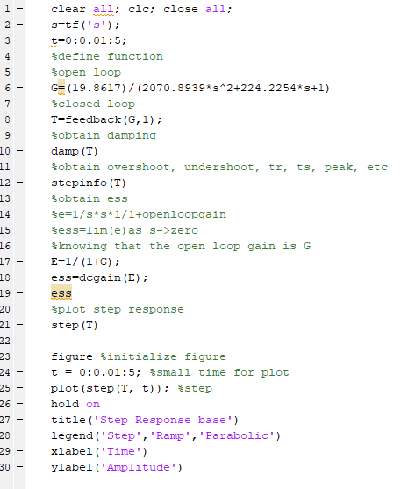
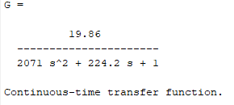
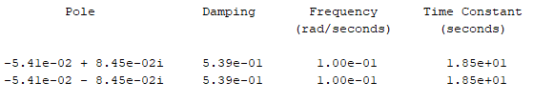
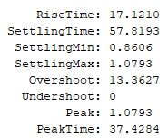

Simulation - Matlab

Slide 6
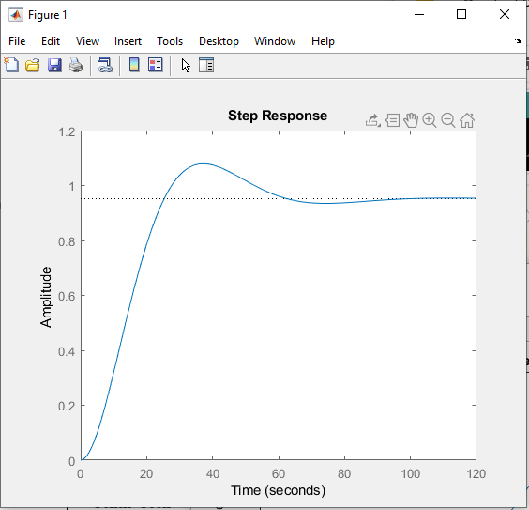
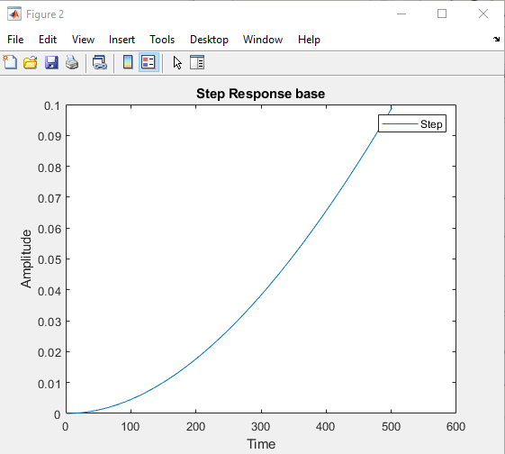
Step Response

Slide 7
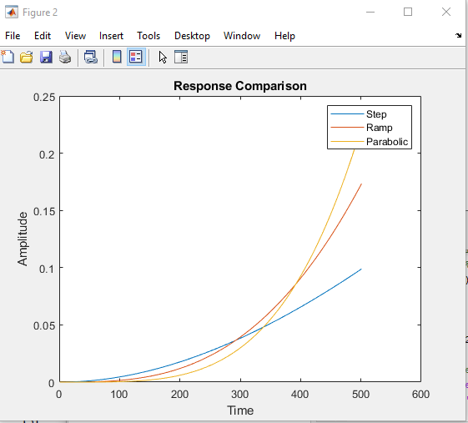
Response comparison

Slide 8
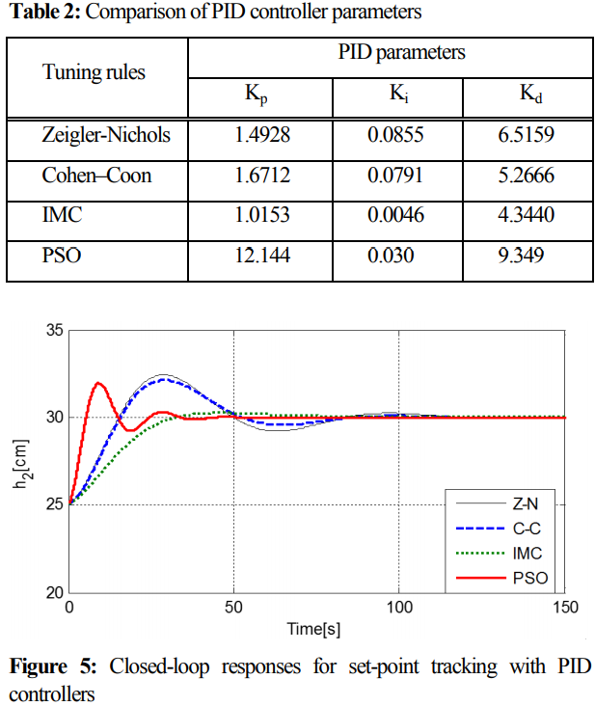
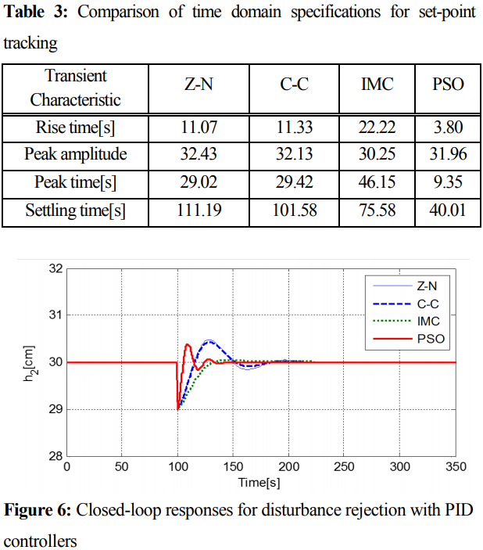
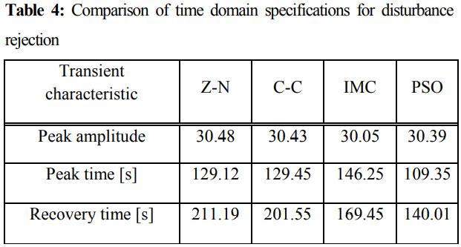
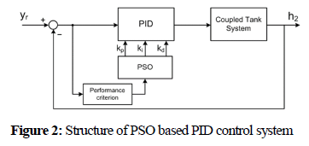
Comparison of parameters in paper (PSO)

Slide 9
Reference
Lee, Yun-Hyung & Ryu, Ki-Tak & Hur, Jae-Jung & So, Myung-Ok. (2014). PSO based tuning of PID controller for coupled tank system. Journal of the Korean Society of Marine Engineering. 38. 1297-1302. 10.5916/jkosme.2014.38.10.1297.
Lee, Yun-Hyung & Jin, Gang-Gyoo & So, Myung-Ok. (2014). Level control of single water tank systems using Fuzzy-PID technique. Journal of the Korean Society of Marine Engineering. 38. 550-556. 10.5916/jkosme.2014.38.5.550.

